Slide 1


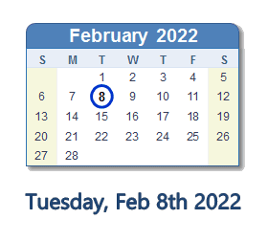
NOTICE OF A SPECIAL Work Session
Zoom Link: https://atlantapublicschools-us.zoom.us/j/82681561524?pwd=WVh1TlViejE1aHhtNC8xU0NjR2R3Zz09
The GO Team of BEST Academy will be holding a 2nd Work Session on Tuesday, February 8th @ 5:00pm to continue work on our School Budget for the 22-23SY.
The meeting will take place via Zoom, we request all members to attend.
The Go Team will discuss:
  School Budget - 22-23SY

